Slide 1
SC-400T00A Microsoft Information Protection and Compliance Administrator
Author name

Slide 2
Manage Insider and Privacy Risk in Microsoft 365

Slide 3
Outline
Prepare Microsoft Purview Communication Compliance
Manage Insider Risk in Microsoft Purview
Implement Microsoft Purview Information Barriers
Manage Regulatory and Privacy Requirements with Microsoft Priva

Slide 4
Prepare Microsoft Purview Communication Compliance

Slide 5
Agenda: Prepare Microsoft Purview Communication Compliance
Set up communication compliance
Investigate and remediate alerts
Plan Information Barriers
Maintain communication compliance

Slide 6
Plan for Communication Compliance
Identify requirements
Collaborate with stakeholders
Create policy
Assign users to role groups
Train on best practices
Use Microsoft 365 dashboard for enforcement
Notes:
Foster a culture of safety and inclusion with Communication Compliance​ - YouTube – 7 minutes
Define compliance requirements by identifying communication data to monitor and legal/regulatory requirements.
Involve stakeholders such as IT staff, compliance officers, privacy experts, security professionals, HR personnel, and legal advisors.
Develop a compliance policy that outlines program scope, purpose, and stakeholder roles/responsibilities.
Assign users to role groups to enforce policy and train them on compliance best practices.
Use the Communication Compliance dashboard in Microsoft 365 to monitor and analyze communication data, and to enforce policy.

Slide 7
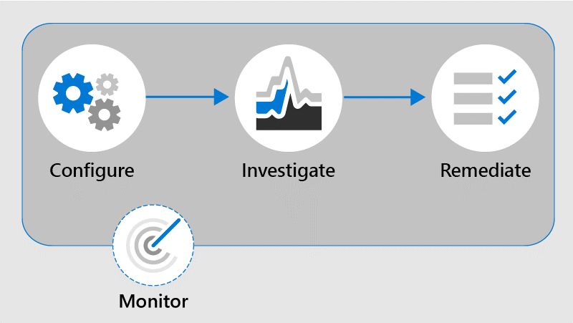
Identify and resolve communication compliance workflow
Notes:
Configure:
Identify compliance requirements and configure communication compliance policies.
Utilize built-in policy templates for quick policy creation.
Investigate:
Use the Microsoft Purview compliance portal for in-depth investigation.
Review alerts generated when messages match policies.
Remediate:
Resolve alerts to address identified issues.
Tag messages as compliant, non-compliant, or questionable.
Monitor:
Continuously evaluate and improve compliance posture.
Review and customize existing policies as needed.

Slide 8
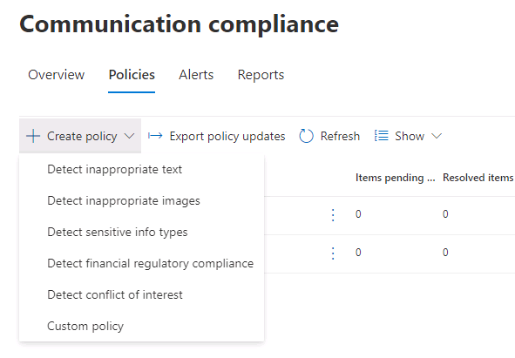
Introduction to communication compliance policies
Inappropriate text: Threat, Discrimination, Harassment classifiers
Inappropriate image: Adult, Racy classifiers
Sensitive info: Predefined patterns, custom dictionary, attachments >1 MB
Financial compliance: Complaints, Gifts, Money laundering, Collusion, Stock manipulation, Unauthorized disclosure
Conflict of interest: None
Notes:
Detect potential communication risks with Microsoft Purview Communication Compliance (cloudguides.com) – Interactive guide (10 minutes)

Slide 9
Introduction to communication compliance policies (cont.)
Policy Settings
Users: Choose between all users or specific users/groups.
Direction: Review inbound, outbound, or internal communications.
Sensitive information types: Identify and protect sensitive data.
Custom keyword dictionaries: Create organization-specific dictionaries.
Classifiers: Scan messages for harassment, profanity, and threats.
Conditional settings: Apply conditions to email and third-party sources.
Review percentage: Specify the percentage of communications to review.

Slide 10
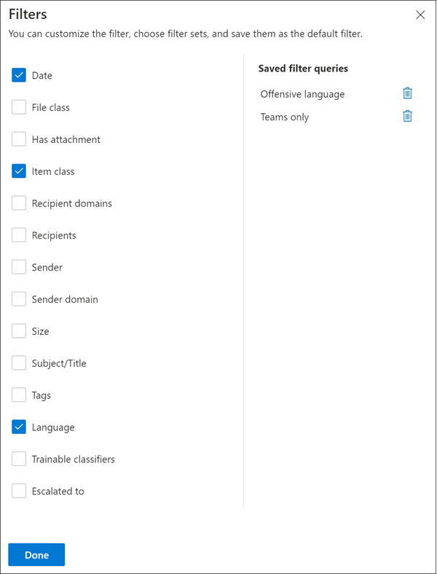
Investigate and remediate communication compliance alerts Communication Compliance Alerts
Review alerts:
Policy page
Alerts
Reports
Sort messages: Use multi-level filtering
Quickly review policy matches
Filter details: Refine investigation
Date, File class, Attachments
Item class, Recipient domains
Recipient, Sender
Notes:
Take action on Microsoft Purview Communication Compliance alerts (cloudguides.com) – Interactive Guide - 10 minutes)
Review alerts:
Importance of accessing the Purview compliance portal for alert management
How alert grouping helps in efficient investigation
Overview of policy page, alerts, and reports for better understanding of compliance issues
Sort messages:
Benefits of using multi-level filtering to narrow down messages
Efficiently reviewing policy matches to identify potential issues
How filtering streamlines the investigation process and saves time
Filter details:
How filters help refine investigations by focusing on specific criteria
Understanding each filter type and its role in the investigation process:
Date: Filter by time range
File class: Filter by file type or category
Has attachment: Filter messages with or without attachments
Item class: Filter by message type (e.g., email, calendar invite)
Recipient domains: Filter by recipient's domain
Recipient: Filter by specific recipient(s)
Sender: Filter by specific sender(s)
Examples of applying filters in various scenarios to improve investigation efficiency

Slide 11
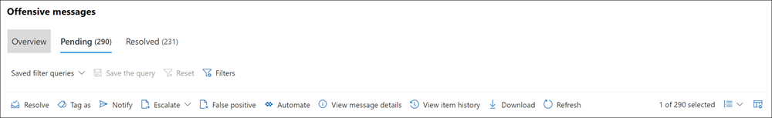
Investigate and remediate communication compliance alerts (cont.)
Examine Basics
Archive
Examine Details
Power Automate
Unresolve Messages
Remediation Action
Notice Templates
Notes:
Examine Basics: Assess source/subject for remediation or review.
Examine Details: Review content, sentiment, attachments, and context.
Remediation Action: Choose from resolve, report, tag, notify, escalate, or remove.
Archive: Export messages to a .ZIP file for external storage.
Power Automate: Automate tasks and alerts with templates.
Notice Templates: Create custom email reminders for policy matches.
Unresolve Messages: Move mistakenly resolved messages back to the Pending view for further investigation or additional actions in Communication Compliance.

Slide 12
Manage alert volume in Communication Compliance
Analyze keyword lists for policy fine-tuning
Utilize data classification dashboard for item volumes
Filter email blasts and false-positive senders
Prioritize messages by sentiment evaluation
Combine trainable classifiers to raise capture threshold

Slide 13
Manage Insider Risk in Microsoft Purview

Slide 14
Agenda: Manage Insider Risk in Microsoft Purview
Insider risk management planning
Insider risk management policies
Insider risk management activities and alerts
Insider risk management cases

Slide 15
Insider risk management overview
Insider Risk Management in Microsoft 365
Trusting employees comes with risks such as threats and illegal behavior
Use Microsoft Purview for insider risk management with real-time signals, machine learning, and integrated workflows
Insider risk management workflow:
Policies: Define scope and risk indicators.
Alerts: Generated based on defined indicators.
Triage: Evaluate and resolve alerts.
Investigate: Create cases for further action.
Action: Take appropriate steps based on investigation.
Insider risk case
Policy
Alerts
Triage
Investigate
Action
Collaboration
Compliance, Human Resources, Legal, Security
Insider risk management workflow
Notes:
Microsoft Purview Insider Risk Management | Admin Set-up Tutorial
https://www.youtube.com/watch?v=og90Rs8tVUA&ab_channel=MicrosoftMechanics
(14 minutes)

Slide 16
Introduction to managing insider risk policies
Purpose
Detect and mitigate potential insider threats
Policy Categories
Data leaks, data theft, sabotage
Policy Templates
Pre-configured with conditions and indicators
Configuration
Select risk indicators and set thresholds
Assign Users/Groups
Apply to specific or all users and groups
Notes:
Insider Risk Management Policy Configuration - https://youtu.be/kudK5ajZTUo – 7 minutes
Insider risk management policies determine:
The users that are in-scope
The types of risk indicators that are configured for alerts
Policies also support content priorities. By doing so, an organization can focus policy conditions on multiple or specific Microsoft Teams, SharePoint sites, data sensitivity types, and data labels
Insider risk management templates are pre-defined policy conditions that define the types of risk indicators and risk scoring model used by the associated policy
Each policy must have a template assigned in the policy creation wizard
Insider risk management supports up to five policies for each policy template
The Policy tab on the Insider risk management dashboard enables an organization to quickly:
Review its policies
Review the health of policies
Manually add users to policies
View the status of alerts associated with each policy

Slide 17
Create and manage insider risk policies
Prerequisites:
Enable audit logging and assign permissions
New Policy Creation:
Use policy wizard
Select templates
Assign users/groups
Configure alert indicators
Potential Dependencies:
Configure HR data and DLP policies
Prepare, configure, and create insider risk management policies.
Notes:
Prerequisites & permissions:
Turn on audit logging for user insights and policy activities.
Assign compliance officers to Insider Risk Management or Insider Risk Management Admin role group.
Choose role groups (Insider Risk Management, Insider Risk Management Admin, Analysts, Investigators) for managing different aspects of insider risk management.
Potential dependencies:
Departing employee data theft template may require configuring Microsoft 365 HR data connector.
HR connector setup includes obtaining consent, assigning Mailbox Import Export role, and uploading HR data from CSV file.
Data leaks template may require assigning a specific DLP policy to drive sensitive information alerts.
Creating a new insider risk policy:
Use the policy wizard in the Microsoft Purview compliance portal.
Configure policy template, apply to users/groups, select alert indicators, and set duration for monitoring.

Slide 18
Investigate insider risk alerts
Risks: Activities generating alerts or posing risks without immediate alerts
Tools: User Activity Reports and Alert Dashboard
User Activity Reports: Examine specific users’ activities without assigning them to a policy
Alerts: Automatically generated by risk indicators defined in policies
Role of Analysts and Investigators: Review current risk status and act on alerts
Notes:
Insider Risk Management Alerts Triage Experience - https://youtu.be/KgmpxBLJLPI - 5 minutes
Investigating risky user activities is an important first step in minimizing insider risks for an organization.
Risks can include activities that generate alerts from insider risk management policies and activities detected by policies that pose risks but don't immediately generate alerts for users.
Organizations can investigate these types of activities by using the User Activity Reports and the Alert Dashboard.
User Activity Reports allow examining specific users' activities for a defined time period without assigning them to an insider risk management policy.
Insider risk management alerts are automatically generated by risk indicators defined in policies.
Alerts provide compliance analysts and investigators with a current risk status view.

Slide 19
Take action on insider risk alerts through cases
Insider risk case management
Assign, investigate, resolve cases
Case dashboard and overview
Summary, activity, content, details
User activity and alerts
Timeline, risks, actions
Content explorer
Access, search, explore data
Assign Users/Groups
Case notes and contributors
Notes:
Take action on insider risk alerts through cases:
Assign alerts to cases for detailed investigation.
Review signals, content, and timeline.
Send notices or escalate for further investigation.
Close cases with specific actions.
Case dashboard:
Displays active and closed cases.
Shows case attributes and statistics.
Filter and search cases.
Case overview and Alerts:
Summarizes alert activity and risk level history.
Displays policy matches, alert status, severity, and detection time.
Provides an overview of content at risk.
User activity:
Offers a timeline of alerts and risk activities.
Shows risk score, categories, and associated events.
Enables actions to contain risks.
Content explorer:
Provides access to items and their locations.
Allows viewing contents of files and emails.
Supports basic and advanced search.
Case notes and Contributors:
Enables commenting and feedback.
Adds insight and maintains case history.
Manages access and contributors.

Slide 20
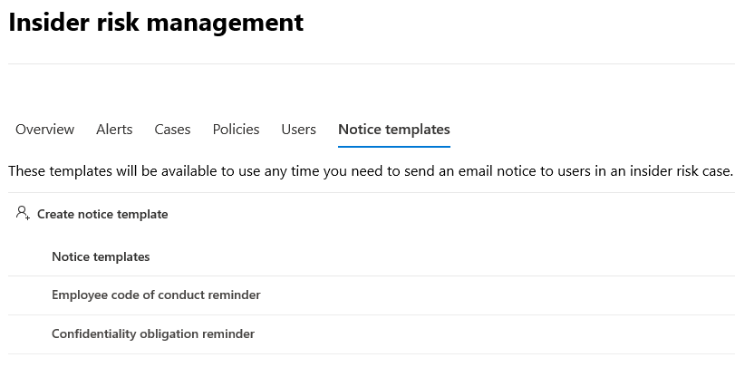
Take action on insider risk alerts through cases (cont.)
Case actions:
Send notice
Escalate for investigation
Resolve the case
Notes:
Case actions:
Analysts and investigators take action.
Consider severity and risk history.
Integrate with Microsoft Purview.
Send notice:
Remind employees via email.
Document actions and policies.
Use notice templates.
Escalate for investigation:
Additional legal review.
Open eDiscovery (Premium) case.
Manage content preservation.
Resolve the case:
Complete review and investigation.
Take action on alerts.
Close case with resolution classification.

Slide 21
Manage forensic evidence
Key Points:
Requirements
Visual context
Customizable triggers
User privacy
Role-based access controls
Integrated features
Trial capacity
Windows 10/11 Enterprise
Physical devices or Hyper-V
Capturing options
Specific activities
All activities

Slide 22
Manage forensic evidence (cont.)
Dashboard Functions:
Alerts dashboard
Cases dashboard
User activity reports
Steps to Manage:
1
2
Confirm subscription & configure data storage access
Configure supported devices
4
3
Create a policy
Configure settings
5
6
Define & approve users
View & manage captured

Slide 23
Create insider risk notice templates
Send email reminders for risk alerts
Remind users to exercise caution
Provide links to training resources
Create a documented audit trail
Update or delete existing templates
Use HTML for detailed messages
Notes:
Notices serve as gentle reminders for users to exercise caution and provide links to training resources or corporate policies
Notices help create a documented audit trail for users with recurring risk activities
The Notices templates dashboard displays a list of configured notice templates and allows you to create new ones
You can use HTML in the message body field of a notice template to create more detailed messages
To create a new notice template, use the notice creation tool in the Microsoft Purview compliance portal
You can update or delete existing notice templates through the Microsoft Purview compliance portal

Slide 24
Implement Microsoft Purview Information Barriers

Slide 25
Agenda
How to configure information barriers
Information barriers in Microsoft Teams
Information barriers in OneDrive
Information barriers in SharePoint Online

Slide 26
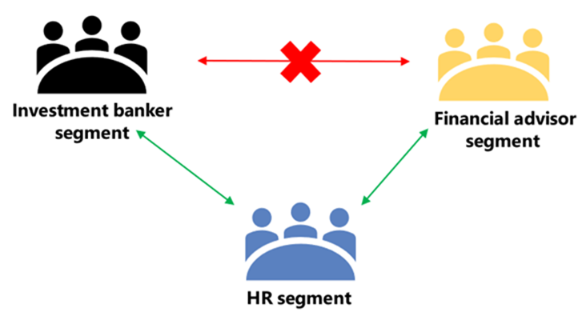
Explore information barriers in Microsoft 365
Information barriers are policies that restrict communication between certain groups within an organization
Compliance solution to restrict two-way communication between groups and users in Teams, SharePoint, and OneDrive
Helps prevent conflicts of interest and safeguard internal information
Apply to various scenarios: Separate departments, schools, or teams handling confidential data
A visual representation of how an information barrier policy works.
Notes:
Information barriers apply to SharePoint Online, Microsoft Teams, and OneDrive services
Supports two-way restrictions for communication and collaboration
Possible scenarios for using information barrier policies:
Prohibit two-way communication or file sharing between users on different teams
Prevent two-way calling or online chat between users in specific groups within the organization
Restrict a user to only call or chat online with a designated team, with two-way limitations
Limit file sharing or access to a site exclusively to members of a specific team, blocking two-way access for others

Slide 27
Configure information barriers in Microsoft Purview
Planning IB Policies:
Consider legal and industry regulations
Determine communication restrictions
Separate policies into Block and Allow
Configuration Steps
Prerequisites: Licenses, permissions, etc.
Segment users in the organization
Define information barrier policies
Apply information barrier policies
Configuration for SharePoint and OneDrive (optional)
Information barrier modes (optional)
Notes:
Planning IB Policies:
Consider legal and industry regulations to determine the compliance requirements.
Identify communication restrictions between groups to define the scope of IB policies.
Categorize policies into Block and Allow to establish communication boundaries.
Configuration Steps:
Ensure prerequisites are met, such as licenses, permissions, and necessary data in the directory.
Segment users based on attributes to create distinct groups for policy application.
Define IB policies specifying communication limits as either Block or Allow.
Apply IB policies by activating them to enforce communication restrictions.
Optionally configure IB for SharePoint and OneDrive to extend restrictions.
Optionally adjust Information Barrier modes to align with specific organizational needs.

Slide 28
Examine information barriers in Microsoft Teams
Information Barriers (IBs) are policies that prevent certain individuals or groups from communicating with each other in Microsoft Teams
Managing Secure and Compliant Communication
IBs prevent communication between individuals or groups in Teams.
Useful for restricting information sharing and isolating groups.
Shared channels support IBs with restrictions based on policies.

Slide 29
Information Barriers in Shared Channels
Shared Channels:
Invite non-team members for collaboration
Information barrier policies affect shared channel configurations
Policies checked to ensure compliance when configuring or adding users
No restrictions on communications between users from different organizations

Slide 30
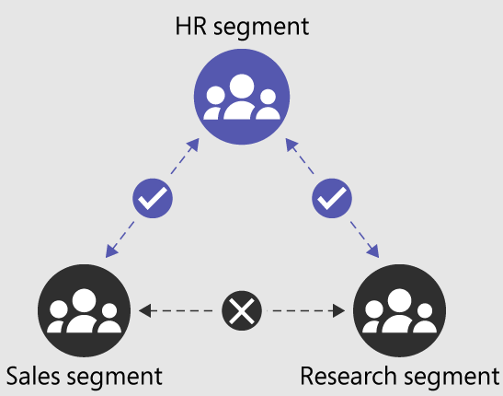
Examine information barriers in OneDrive
Purpose:
Determine and prevent unauthorized collaborations in OneDrive
Unauthorized Collaborations:
User access, Sharing of OneDrive or stored content
Information Barrier Modes:
Open, Owner Moderated, Explicit, Inferred
Notes:
Information barriers in OneDrive can prevent unauthorized collaborations by controlling user access to OneDrive or stored content, and by limiting sharing of OneDrive or stored content with other users.
OneDrive supports different information barrier modes when used with an organization, including Open, Owner Moderated, Explicit, and Inferred.
The Open mode allows unrestricted sharing of OneDrive content, while Owner Moderated mode requires approval from the content owner before sharing can occur.
The Explicit mode restricts sharing based on pre-defined policies, and the Inferred mode automatically blocks sharing based on factors such as job title or department.
By using information barriers in OneDrive, organizations can maintain greater control over the flow of information and reduce the risk of unauthorized sharing or exposure of sensitive data.

Slide 31
Examine information barriers in SharePoint
Information barriers prevent unauthorized collaboration in SharePoint
They control adding users, accessing content, and sharing
Four modes are supported: Open, Owner Moderated, Explicit, and Inferred
Open mode allows sharing with mail-enabled security groups (opt-in)
Notes:
Definition: Information barriers in SharePoint can prevent unauthorized collaborations by controlling user access and sharing of site content.
Types of Unauthorized Collaborations: Adding a user to a site, user access to a site or site content, sharing a site or site content with other users.
Supported Information Barrier Modes: Open, Owner Moderated (preview), Explicit, Inferred.
Administration: SharePoint Administrators or Global Administrators can view and manage segments on a SharePoint site.
Limits: Up to 5,000 segments per organization, and users can be assigned to multiple segments (except for organizations in Legacy mode).
Tools for Managing Information Barriers: SharePoint Admin Center, SharePoint PowerShell, SharePoint REST API.
Auditing: Audit events are available in the Microsoft Purview compliance portal.
Microsoft Teams Integration: Microsoft Teams sites are automatically created for the team's files, and information barriers can be enabled for them.
Effects of Changes: Users' access to site or content is determined by the site's IB mode.
Suspend Information Barriers: Can be done temporarily using SharePoint Online Management Shell and Set-SPOTenant cmdlet.
Additional Capability: Mail-enabled security group support for Open mode sites (with prerequisites).

Slide 32
Manage Regulatory and Privacy Requirements with Microsoft Priva

Slide 33
Agenda: Manage Regulatory and Privacy Requirements with Microsoft Priva
Manage privacy risks using Priva
Develop and optimize policies
Address personal data risks
Handle subject rights requests

Slide 34
Create and manage risk management policies
Empowering Users to Protect Personal Data
Discover and classify sensitive information with data handling policies
Monitor and manage privacy risks in real-time
Enable users to take immediate action to minimize privacy risks
Cultivate better habits for preventing future privacy issues

Slide 35
Create and manage risk management policies (continued)
Policy Templates
Data overexposure policy:
Identify content items containing personal data that may be too broadly accessible
Data transfers policy:
Monitor and manage the transfer of sensitive information
Data minimization policy:
Ensure that personal data is only stored for as long as necessary
Email notifications with built-in remediation actions
Customizable policy creation for specific users, groups, and sensitive information types

Slide 36
Create and manage risk management policies (continued)
Choose data to monitor
Select data types or groups for policy monitoring.
Define outcomes
Configure outcomes, notifications, and Teams tips.
1
5
Choose users and groups
Apply policy to all or specific users/groups. Choose users/groups as needed.
Set alerts
Set alerts, frequency, thresholds, and severity for policies.
2
6
Choose locations
Select locations for policy: Exchange, OneDrive, Teams, SharePoint.
Test your policy
Test mode: no alerts, no notifications, review insights.
3
7
Set conditions
Different policy templates have unique conditions
4
8
Turn on/off a policy
Toggle policy: test mode, turn on, or turn off.

Slide 37
Investigate and remediate risk management alerts
Admins can review alerts and take action on data policies
Alerts can be reviewed and issues can be created for further investigation
Issues can be managed on a dedicated page, allowing users to review and close cases
Users can collaborate and share issues with team members via secure channels
Notes:
Admins can review alerts about content that matches policy conditions in Priva
Identify cases that need follow-up by creating issues
Collaboratively work towards remediating issues with structured reviews
Content owners can take corrective actions directly from notifications or Teams messages
Overview page provides a view into recent findings and key areas of concern
Access visualizations and details about alerts and issues via the Policies page
Evaluate active alerts and specify which ones require follow-up with the Alerts page
Filterable list of alerts generated by policies available on the Alerts page
Manage open issues with the Issues page
Prioritize cases based on severity level
Review content and remediate issues by taking actions like notifying owners or applying retention or sensitivity labels
Share issues with additional members of your enterprise via Microsoft Teams, email, or a direct link
Efficiently manage privacy risks with Priva by collaborating on structured reviews and taking corrective actions quickly.

Slide 38
Create rights requests
Streamlining the Management of Personal Data Requests
Automate the processing of subject rights requests
Ensure timely and accurate responses to personal data requests
Simplify the management of personal data across your organization
Maintain compliance with data protection regulations

Slide 39
Create rights requests (cont.)
Create a request
Use templates or guided custom option
1
Request types
Access, Export, Tagged list, Delete (preview)
2
Getting started
Use default settings for trial, explore features
3
Define search settings
Refine search, include content, get data estimate
4
Notes:
Users need to hold all roles in the Subject Rights Request Administrators role group to create a request
Two ways to create a request: from a template or through a guided custom process
Four types of requests supported: Access, Export, Tagged list for follow-up, and Delete (preview)
Simple, out-of-box setup available to explore functionality of subject rights request workflow
Template option available for quick setup with default settings
Custom option provides guided process to walk through all settings
Ability to refine search settings for data retrieval
Advanced search options available to refine search criteria
Data estimate provides estimate of data to be retrieved before automatic retrieval
Ability to preview and redact data before final report
Automatic progression of request from Data estimate to Data retrieval, unless paused at the estimate stage
Ability to upload additional material to enable Priva to identify data subjects based on exact data values.

Slide 40
Create rights requests (continued)
Quick Setup
Custom Setup
Use a template with default settings
Streamlined search results
Tailored for different relationships (e.g., current employee, former employee, customer)
Easy request creation process
Guided process to choose all settings
Customize policy for specific needs
Flexible search settings
Control over data estimate stage and other search settings

Slide 41
Manage data estimate and retrieval for rights requests
Priva searches for matches to the data subject in your Microsoft 365 environment.
Data estimate summary card shows the estimated number of items.
Request may pause at Data estimate stage for two reasons:
User chose to get an estimate first.
Estimate returns a large number of items (over 10K).
View and edit search queries to refine the search.
Retrieve data stage collects files, emails, chats, images, and other content items.

Slide 42
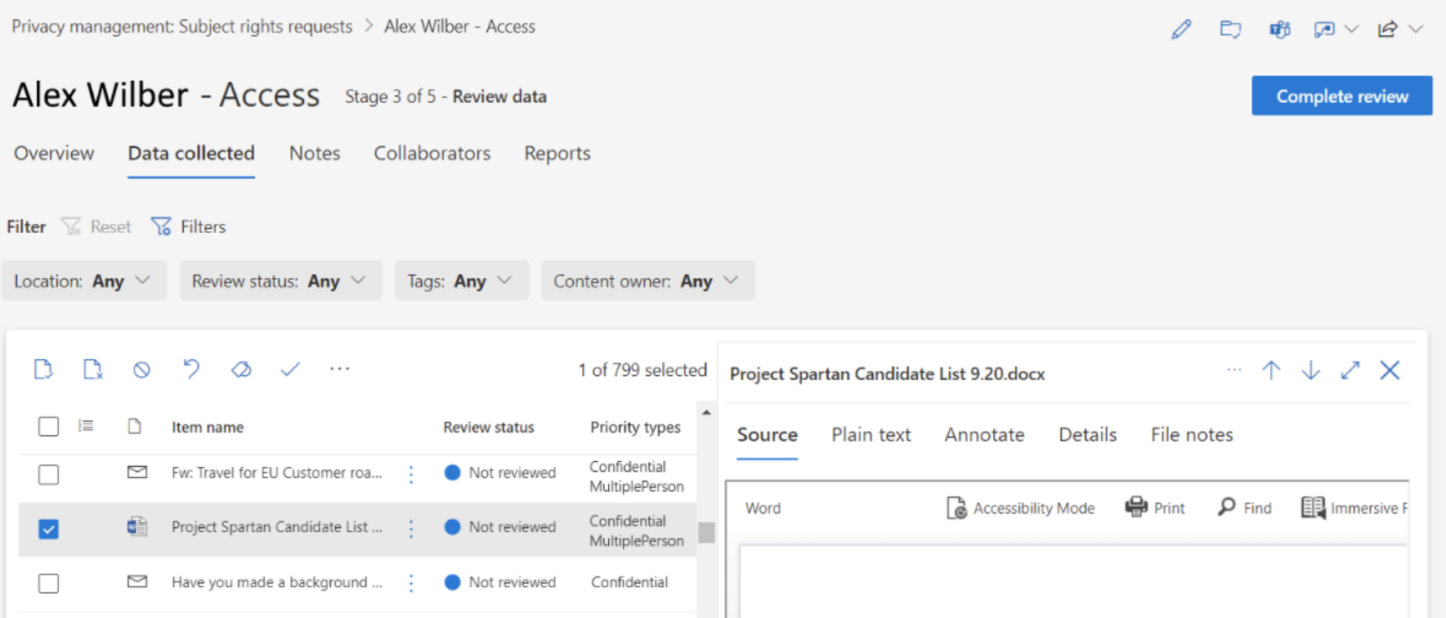
Review data from rights requests
Notes:
Review Data for Subject Rights Requests
Review content items on the Data collected tab.
Collaborate with stakeholders using a Teams channel.
Import additional files (max 4 MB per file) into the Data collected tab.
Mark items as Include or Exclude and add notes.
Apply tags (Follow-up, Delete, Update, and custom tags) to identify items needing further attention.

Slide 43
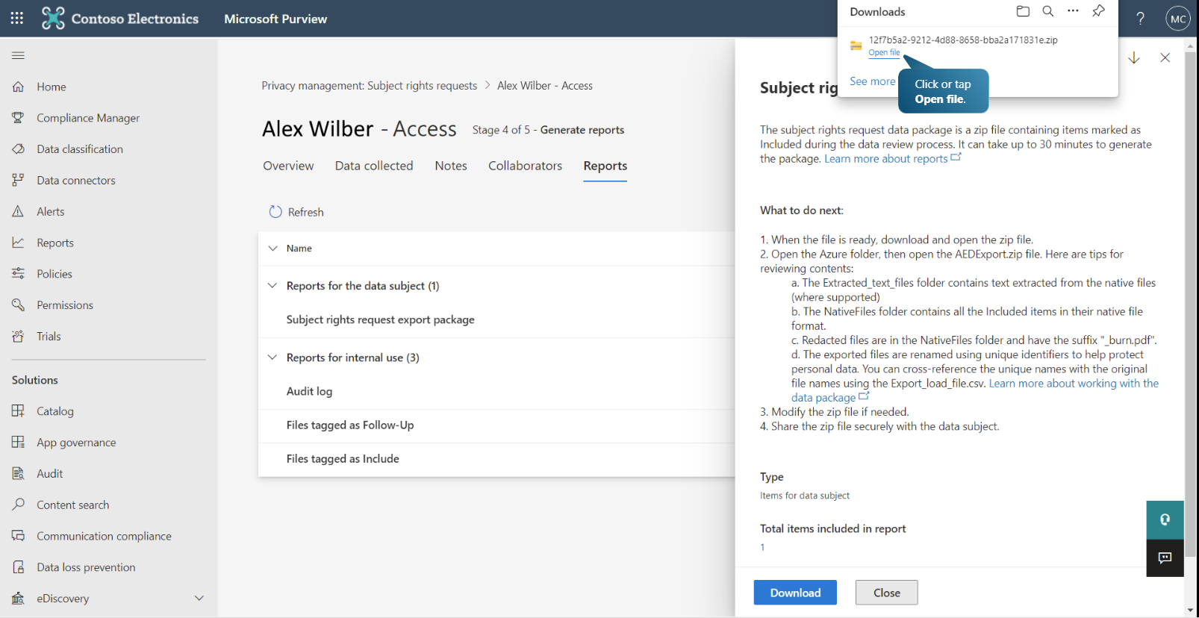
Get reports from rights requests
Notes:
After completing a data review for a subject rights request, you need to generate reports to fulfill the request. Priva creates reports and collects files marked as "Include" during the data review process. These files can be submitted to the data subject to complete their request.
Understanding reports:
Reports are generated automatically after completing the data review.
Reports are divided into two sections:
Reports for the data subject: Contain information to be returned to the data subject.
Reports for internal use: For your organization's internal records related to the subject rights request.
Data package:
The data package contains items marked as "Include" during the data review stage.
The data package is generated as a zip file.
The zip file contains:
A folder named "Azure": Contains key materials for the data subject.
Files outside the "Azure" folder: Spreadsheets named "Results" and "Summary" for reference and internal use.
Azure folder contents:
Extracted_text_files folder: Contains text extracted from native files.
NativeFiles folder: Contains items marked as "Included" in their native file format.
Export_load_file.csv file: Contains original file names for cross-referencing with unique file names in the NativeFiles folder.
Summary text file: Provides a summary of file types, number of files, and their size.
What to do with the folder contents:
Review the items and determine what to send to the data subject.
Modify the zip file to remove any content you don't want to include in the final package.
Send the zip file securely to the data subject who made the request.

Slide 44
Knowledge check
1
If you want to define past and future review periods that are triggered after policy matches based on events and activities for the insider risk management policy templates, which policy setting do you select?
Indicators
Policy timeframes
Intelligent detections
2
Which of the case actions opens a new eDiscovery (Premium) case in your insider risk investigation?
Escalate for investigation
Send a notice
Resolve the case
3
You want to search for insider risk alerts that occurred in the past 30 days and are high severity risks. The easiest way to accomplish this is to do which of the following?
From the Alerts dashboard search for “last 30 days.
Click “Export” to download a CSV file with all alerts. Import this into Excel and use the filter function.
From the Alerts dashboard, select the Filter control.

Slide 45
Manage insider and privacy risk in Microsoft 365 Labs

Slide 46
Lab Exercises
Exercise 1 – Configure Communication Compliance
Exercise 2 – Configure Insider Risk Management
Exercise 3 – Configure Information Barriers

Slide 47
Closing slide

